Slide 1
Prisca Nemapare, Ph.D.
Chief Programme Officer

Slide 2
WEAVING HOPE
FOR RURAL WOMEN
CHILDREN
COMMUNITY
COUNTRY

Slide 3
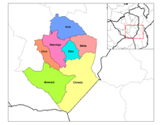
LOCATION
MASVINGO PROVINCE CHIVI DISTRICT

Slide 4
INTRODUCTION
ZIENZELE FOUNDATION was registered as a Trust in Zimbabwe in 2001.
MISSION – 2 pronged
Education of Orphans and Vulnerable Children
Enabling caregivers improve their livelihoods

Slide 5
ORGANISATION
WE SERVE AIDS ORPHANS AND VULNERABLE CHILDREN (OVCs)
THERE ARE 13 PRIMARY SCHOOLS AND 7 SECONDARY SCHOOLS,
THERE ARE 3 COORDINATORS WHO OVERSEE REPRESENTATIVES AT EACH PRIMARY SCHOOL
REPRESENTATIVES ARE SELECTED BY GROUPS OF WOMEN INVOLVED IN PROJECTS AT EACH SCHOOL.

Slide 6
COORDINATORS AND REPRESENTATIVES
COORDINATORS ARE ASSIGNED SCHOOLS TO SUPERVISE –
IT IS COORDINATORS WHO WORK TOGETHER WITH REPRESENTATIVE AT EACH SCHOOL TO MAKE SURE ITS ORPHANS ON THE LIST AND PROJECTS ARE PROPERLY RUN ACCORDING TO OUR AGREEMENT.
THEY ALSO HIGHLIGHT ANY ISSUES
THESE ARE ALL VOLUNTEERS

Slide 7
HOW DO WE ACHIEVE THIS
OVCs ARE ASSISTED WITH SCHOOL FEES
PRIMARY – 13 SCHOOLS
SECONDARY - 8 SCHOOLS
TERTIARY – 1 – POLYTECH COLLEGE

Slide 8
HOW DO WE ACHIEVE THIS-Cont.
CAREGIVERS
PROJECT DEVELOPMENT
TYPE No.
BASKETRY - 32
SEWING - 9
GARDENING 33
SOME LIVESTOCK 3
WORKSHOPS – CHILDREN, YOUTH, WOMEN, MEN
(This is in collaboration with BHASO)

Slide 9
PROJECT GROUPS
WOMEN GROUPED THEMSELVES AT EACH SCHOOL
THERE ARE 2-3 GROUPS OF WOMEN WHO MAKE BASKETS AT EACH SCHOOL
AT THE OUTSET, WOMEN ARE TASKED WITH RESPONSIBILITIES
THEY ARE INFORMED THAT THEY ARE THE ONES IN CHARGE OF EVERYTHING – FROM ORGANISING THEMSELVES THROUGH PRODUCTION

Slide 10
THE WEAVERS

Slide 11
GROUP RESPONSIBILITIES
WRITE A CONSTITUTION
GOVERNING RULES AND REGULATIONS
Meet Wednesdays – teach each other weaving
Decide on fines for tardiness & absences
SELECT A REPRESENTATIVE
SELECT COMMITTEE MEMBERS (7)
SIGN A CONTRACT WITH ZIENZELE

Slide 12
KEY TO MAKING IT WORK
LISTENING
PATIENCE AND RESPECTING EACH OTHER
MOTIVATION & COMMITMENT
COHESION OF GROUPS
TEAM EFFORT AND COOPERATION
VALUE THE WOMEN AND THEIR SKILLS
ACCOUNTABILITY & TRANSPARENCY
INCLUSIVENESS

Slide 13
BEGINNING THE BUSINESS
NETWORKING
PARTICIPATING IN FAIRS
CONNECTING WITH SHOP OWNERS

Slide 14
THE NEW BASKET WORKSHOP
THE NEW BASKET WORKSHOP (TNBW)
ZIMBABWE RESOURCE PUBLICATION
INDIA-ZIMBABAWE PARTNERSHIP
NATIONAL INSTITUDE OF DESIGN OF INDIA

Slide 15
NATIONAL INSTITUTE OF DESIGN
THEY WANTED TO WORK WITH WEAVERS USING SISAL
THEY VISITED US IN MARCH 2012 – FOR AN ASSESSMENT OF WHAT THE WEAVERS WERE INVOLVED IN, PRODUCTS USED, ETC.
JULY, 2012 25 ARTISANS FROM ACROSS THE COUNTRY WERE SELECTED TO GO TO INDIA FOR A TWO WEEK WORKSHOP ON DESIGN.

Slide 16
NID - CONT.
FROM OUR GROUP, 9 WEAVERS WERE SELECTED
THEY WERE SELECTED ON THE BASIS THAT ON RETURN THEY HAD TO TEACH OTHERS
NID CAME BACK TO ZIMBABWE IN OCTOBER AND CONTINUED INSTRUCTION WHICH INVOLVED MORE WEAVERS.
THIS CULMINATED IN THE EXHIBITION ON NOVEMBER 11, 2012.

Slide 17
TRANSFORMATION POINT
THE NEW DESIGNS
SIMPLY WERE UNPRECEDENTED
QUALITY
FORM AND WEAVE
NEW DYES AND PATTERNS
NEW WEAVING PATTERNS

Slide 18
WAVE PLATE

Slide 19
DIFFERENT SHAPE BASKETS

Slide 20
LAMP SHADES

Slide 21
SHOOTING STAR PATTERNS

Slide 22
THE NEW DESIGNS

Slide 23
LARGE SIZE BASKETS

Slide 24
NEW PATTERNS

Slide 25
JEWELLARY BASKET

Slide 26
HARI ON A MAT

Slide 27
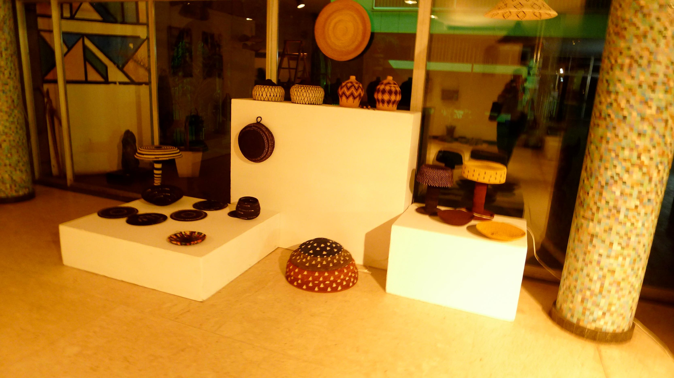
GALLERY EXHIBITION

Slide 28
NID TEAM

Slide 29
THE WEAVERS

Slide 30
RESULTS
ECONOMIC EMPOWERMENT
INCREASE IN SELF-ESTEEM
MICROLENDING
PAYMENT OF SCHOOL FEES
SPEAR HEADING PROJECTS THEMSELVES
SOCIALISING

Slide 31
ORDERS

Slide 32
EARNINGS FROM ORDERS

Slide 33
TABLE RUNNER

Slide 34
BREAD BASKET

Slide 35
BASKET SHOW

Slide 36
CHALLENGES
BUSINESS SKILLS
MEETING ORDERS ON TIME
QUALITY CONTROL OF PRODUCTS
FINDING MARKETS
VALUING THEIR SKILL AND WORK

Slide 37
END

